Slide 1

GUNS AND MONEY
DECARBONIZATION IN EUROPE, CHINA AND THE UNITED STATES

Slide 2
RIPE submission with Xuan Li and Ch 5: Chinese financial statecraft for Green Tech Domination
Cornel Ban
Copenhagen Business School

Slide 3
Structure
Book overview
Article (bulk)

Slide 4

1. Book overview and dues

Slide 5
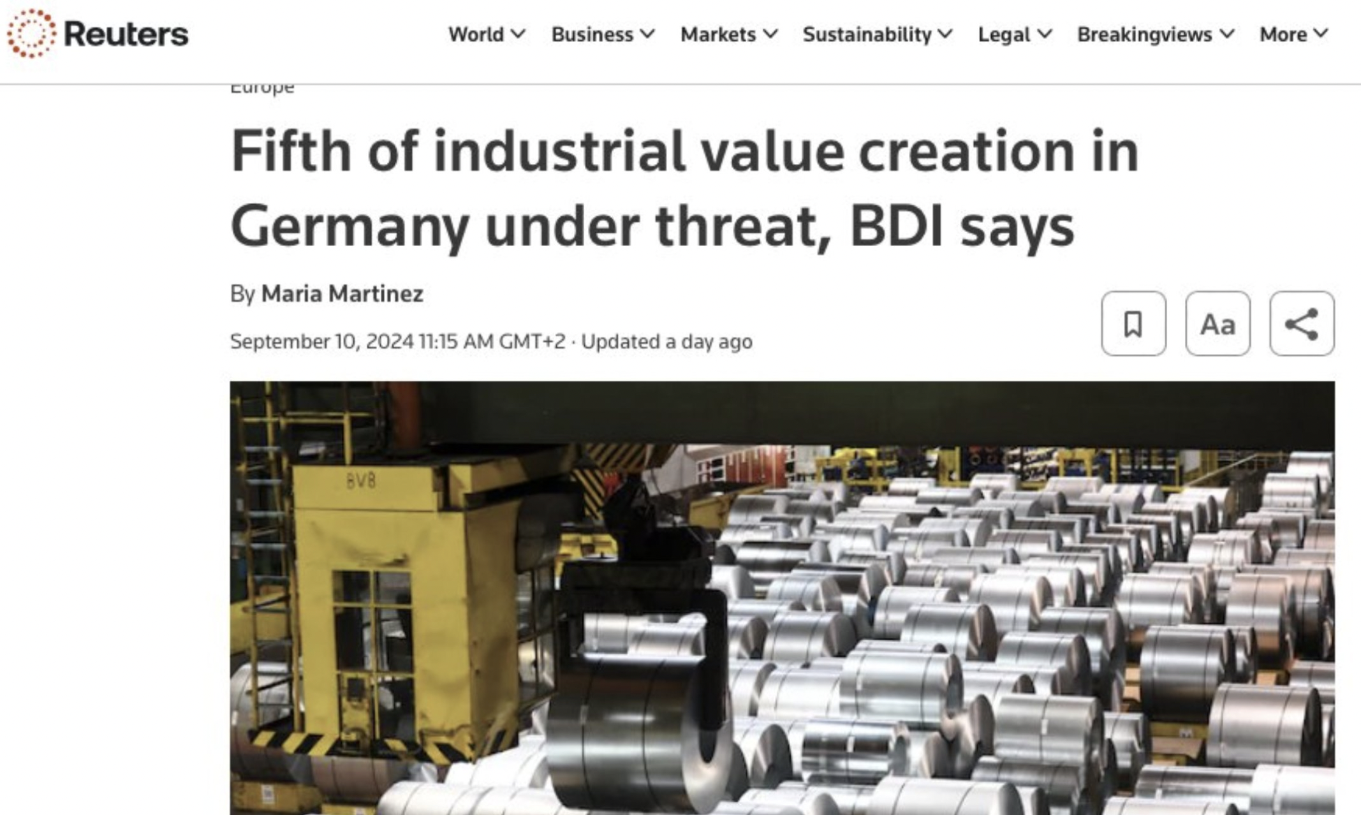

Slide 6
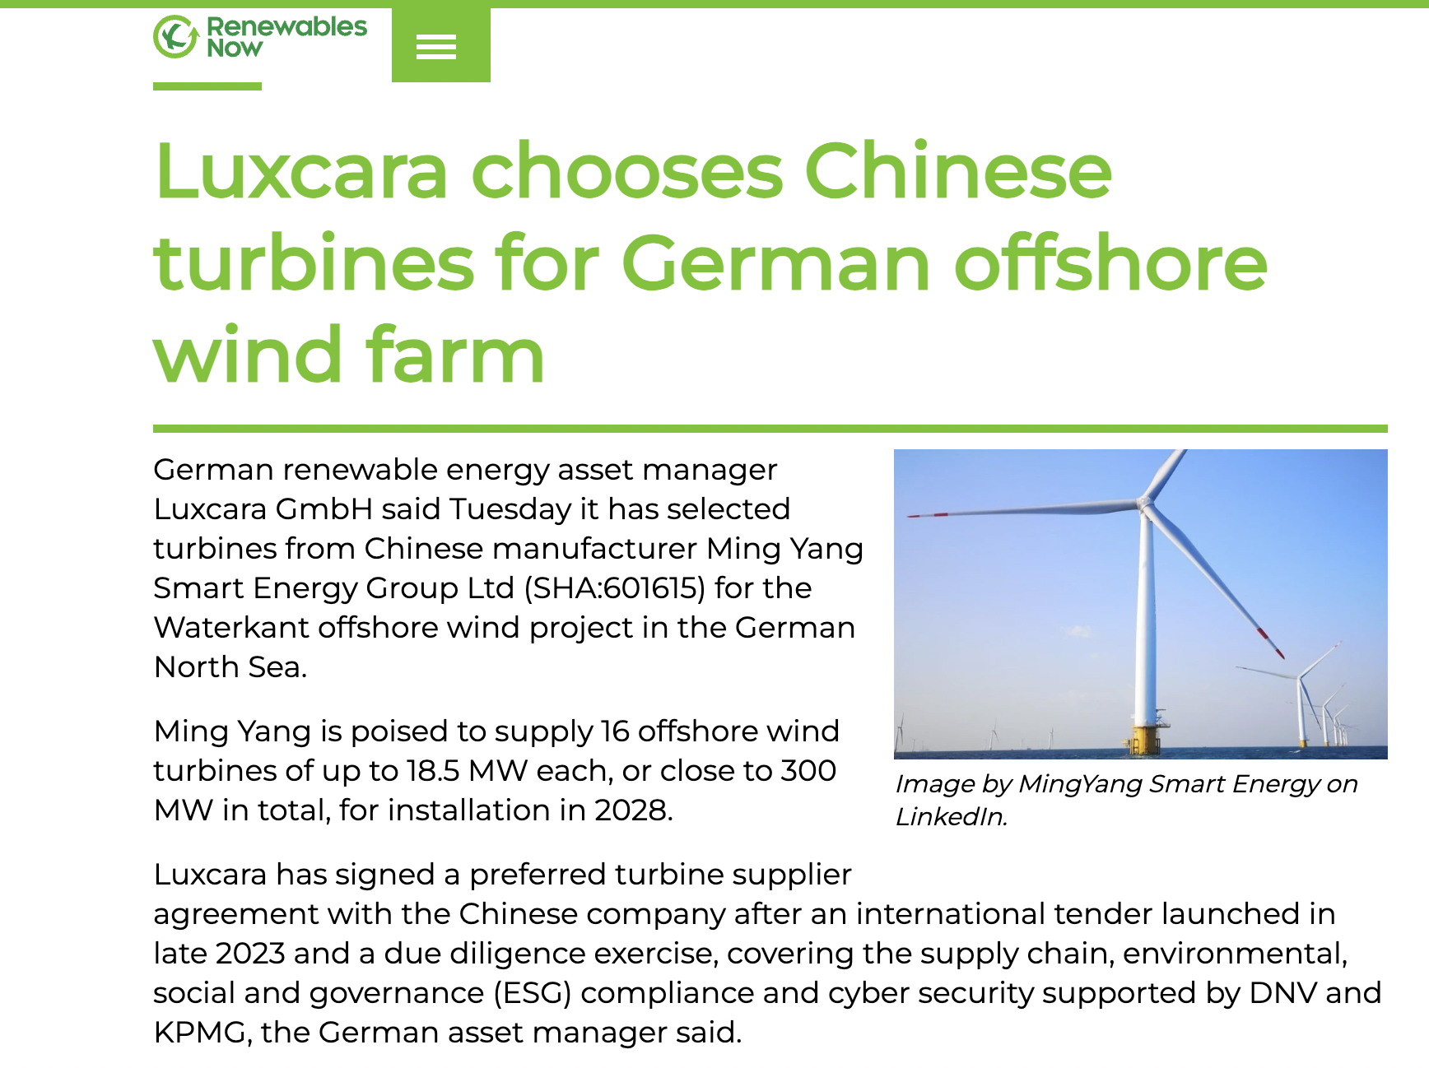
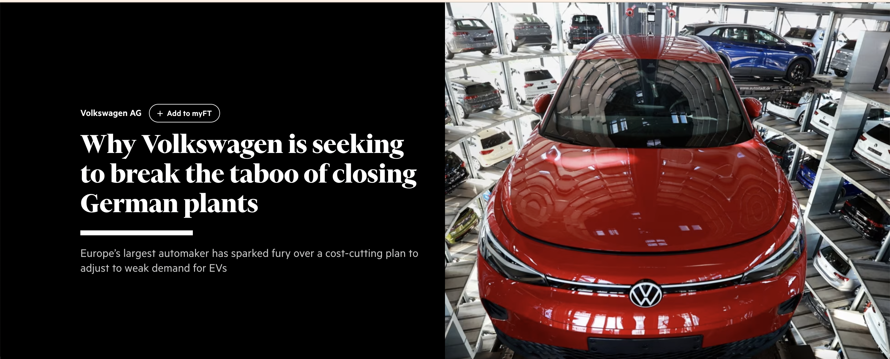
Faces of deindustrialisation

Slide 7
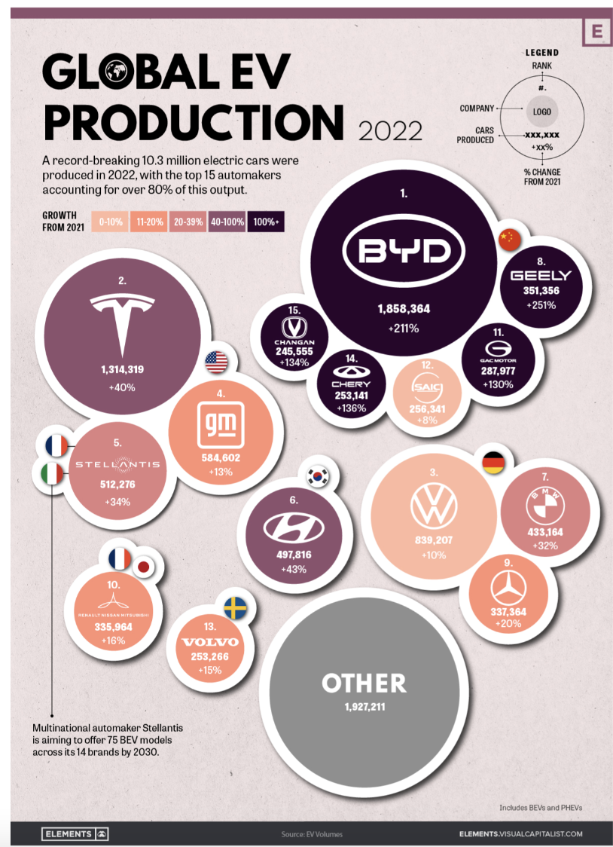
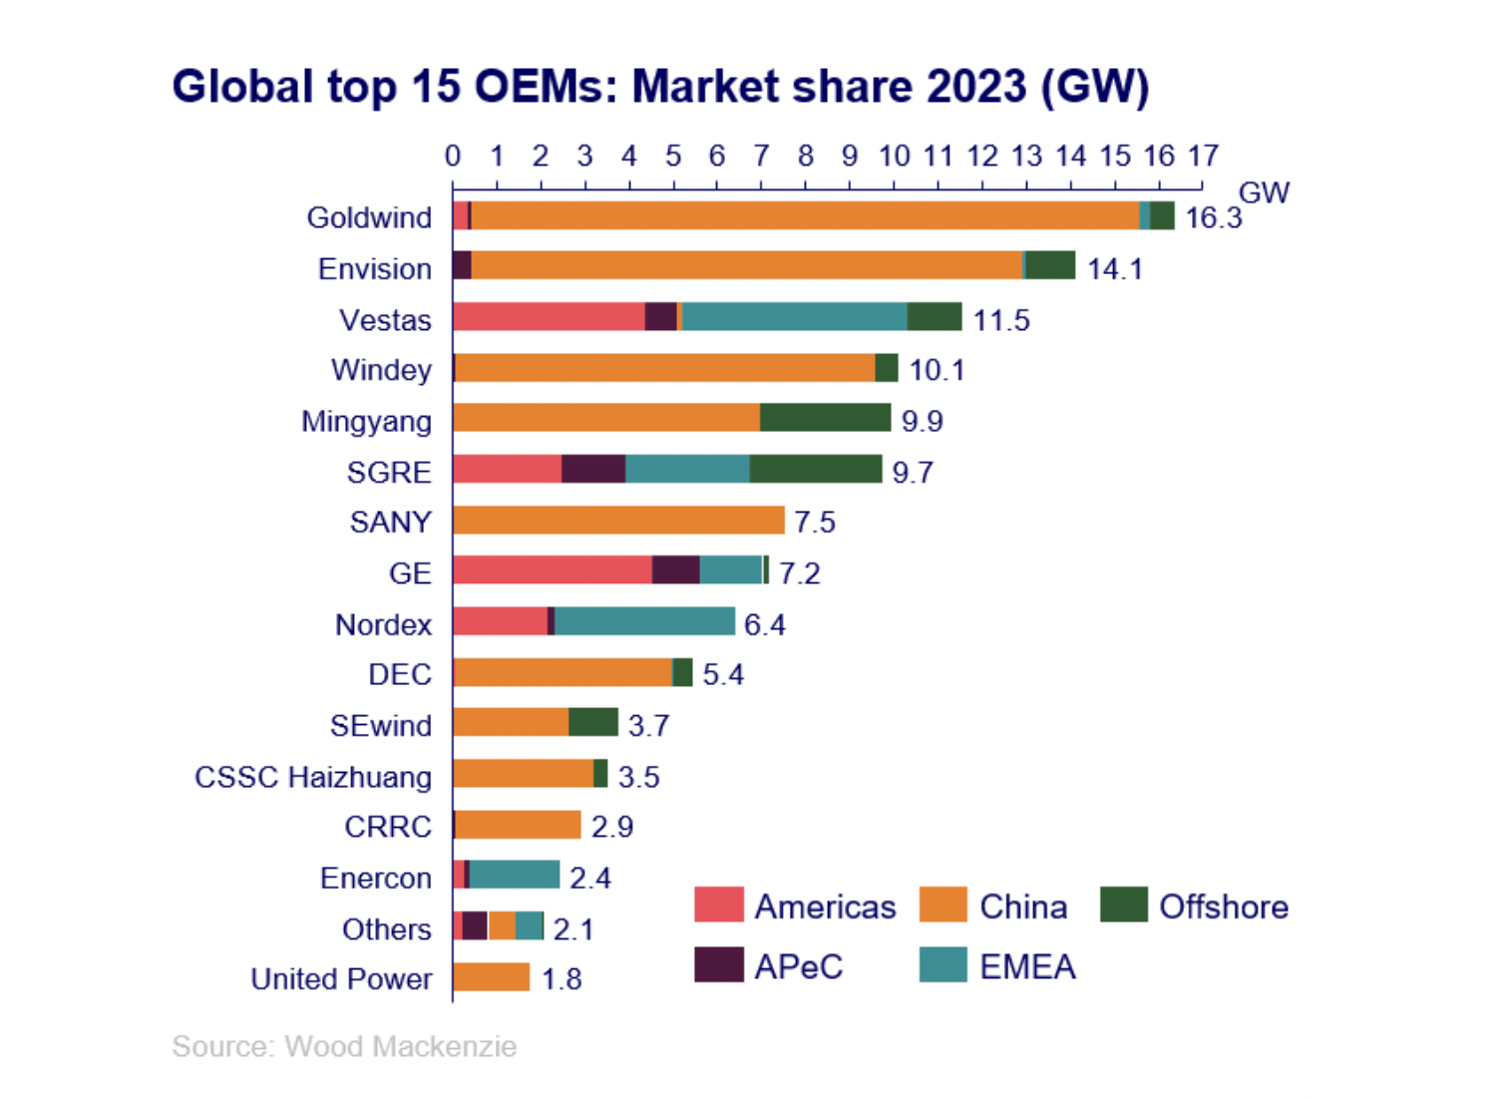
Losing the race

Slide 8
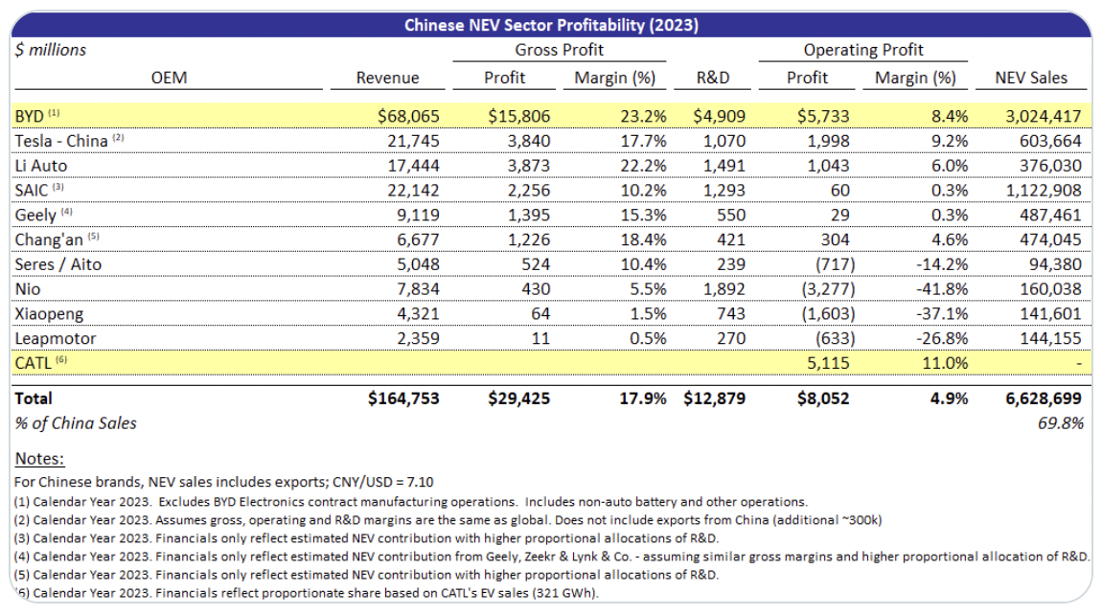
Chinese green tech supremacy is commercially sound
For automakers representing ~70% of China's NEV production.
Contrary to popular belief, NEVs are profitable in aggregate, with the lionshare of the gross margin and profits concentrated with BYD and CATL.
Notes:
https://x.com/GlennLuk/status/1830257660463354251

Slide 9
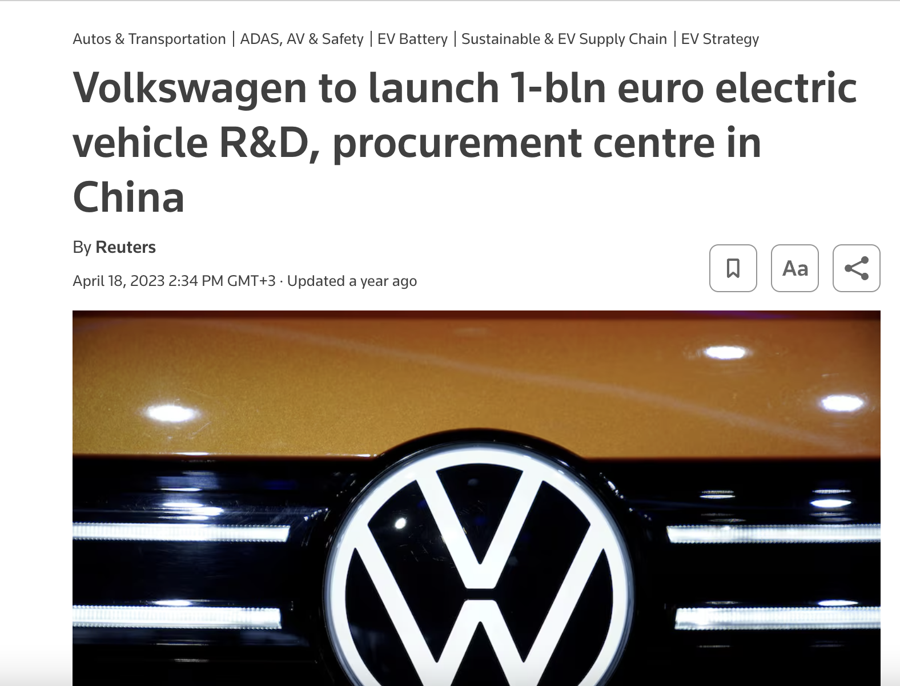

Moreover…
Leading Chinese EV manufacturers are enjoying production cost advantages as a
result of production efficiencies,
tech innovation, and
vertically integrated business models

Slide 10
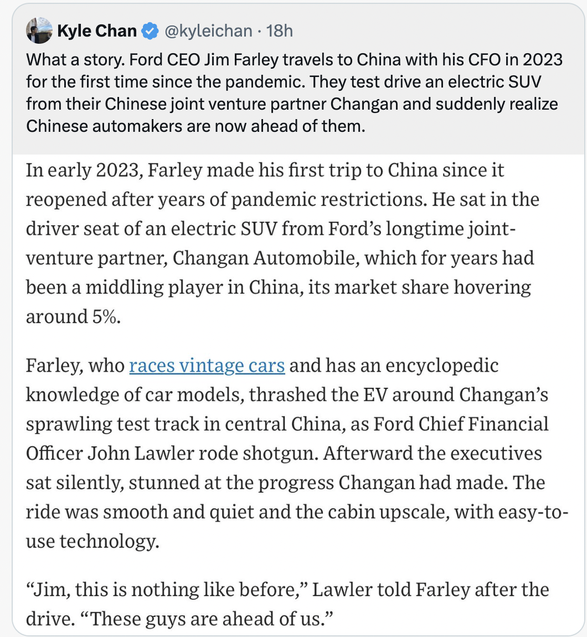
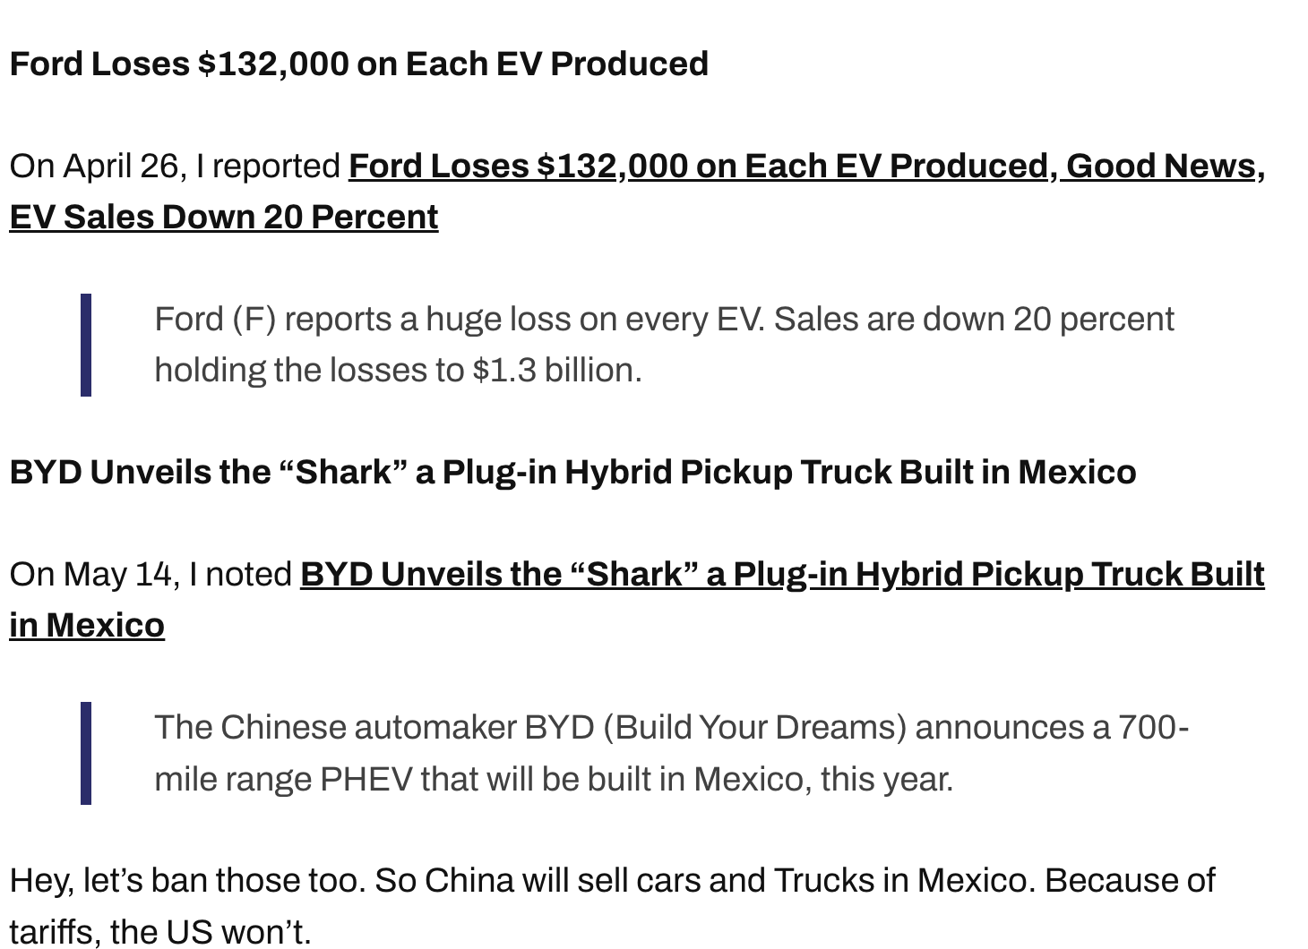
From the mouth of Ford CEO
Notes:
https://mishtalk.com/economics/chinese-automakers-are-far-ahead-of-ford-and-gm-on-cost-and-quality/

Slide 11
What is this about?
Research puzzle: Why has Europe gone from trailblazer on green technology to lagging behind China?
Why puzzling:
EU should have advanced the boldest state-led decarbonization policy due to it being a pioneer in green regulation, having the weakest power of high emission sectors, and the highest technocratic capacity on decarbonization.
It also had first mover advantage on green tech, the most intense popular support, the earliest central bank integration of the green agenda, and some of the largest state-owned banks in the world.
The US lacked all this, which is why it should have embraced liberal decarbonization, not the liberal neo-mercantilist hybrid.
China had strong state finance but lacked the other strengths, while the domestic legitimacy of the state relied on delivering growth rates best obtained via the old carbon economy. So, one would expect China to use its developmental state for conventional growth, but not for “turbocharging” decarbonization.
What explains these surprising and diverging paths?

Slide 12
How much does it matter?
Wind turbines
Automotive
Denmark: 8% of total exports
Denmark: 1% of total jobs
EU: 0.5 % of total EU exports
EU: 0.33% of total jobs
Germany: 20% of total EU exports
Germany: 8% of total jobs
EU: 12% of total exports
EU: 7% of total workers

Slide 13
Wondering why China wins on decarbonization technology
Short answer: Europe has a weaker decarbonization regime (policies, rules, norms, and institutions that govern green tech innovation and scaling) which in turn reflects weaker securitization incentives and weaker macrofinancial framework for financial statecraft and industrial policy. US does better but the decarbonization regime is more politically contested by brown coalitions
Theoretical question: What explains variation in decarbonization regimes in the first place?

Slide 14
What explains variation in decarbonization regimes? GUNS
.
Securitization incentives: IR realism sees changes in relative power differentials between great powers as shaping domestic policy regimes relevant to national security; As Chinese economic, political and military power grew relative to the US, US defined China as a security threat to be contained,
This triggered in China a defensive reaction in China that included the weaponization of industrial policy and particularly of innovation-heavy components based on the understanding of rivalry as adjudicated primarily on technological terms
Europe does not feel this urgency under the US security umbrella and focuses instead on an ordoliberal policy regime disciplining an export-oriented growth regime that maximized its industrial interdependence with China
Since green technologies and energy security represented unique opportunities to leapfrog Western incumbents and establish value chain dominance in the technologies of decarbonization needed by the rest of the world, China’s security policy became intertwined with its decarbonization policy

Slide 15
What explains variation in decarbonization regimes? MONEY
Macrofinancial frameworks
1. Green monetary policy carried out by a subordinated central bank
2. Socially austere but spending-based green fiscal policy floods green technologies with public procurement and subsidized private demand
3. Politically subordinated state-owned promotional bank sector executes green credit and guarantees for scaling up incumbent green technologies
4. Politically subordinated but highly localized Governance Guidance Funds execute equity investments in innovation-heavy green technology ventures chasing opportunities based on territorially defined advantages
5. Indicative planning anchors all four into a coherent yet experimental whole

Slide 16

Book chapters
1. Introduction: decarbonization regimes, possibilism, transformationalism, theory of green statecraft variation, IR realism and CPE: the macrofinance-security nexus
2. EU: The making of green derisking statecraft (EC, ECB, EIB and investment states)
3. Germany’s Green (Ordo)liberalism: Das Auto and the BEV challenge
4. Denmark’s Quiet Stop-Go Economic Statecraft : Rise and Decline of Big Wind
5. China: The making of green financial statecraft (NDRC; PBOC; GGFs)
6. China’s socialist developmentalism: Big BEV Rising and Big Wind
7. America’s green mercantilist turn: IRA and the fragility of primacy management
8. Conclusions

Slide 17
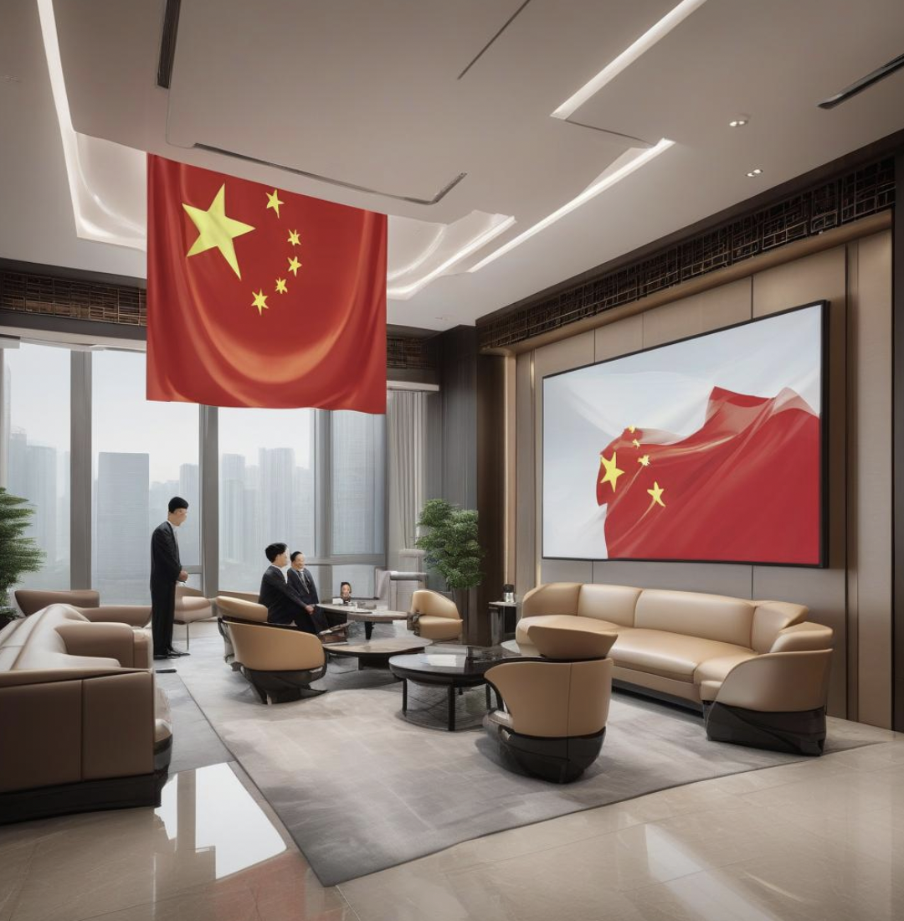
Non-bank money and the venture capitalist state in a Leninist political system
GGFs: “funds established by governments at all administrative levels through fiscal spending, non-fiscal state capital, or state capital partially joint with private capital, that engages in equity investment to invest in key technologies and weak areas of economic and social development, and to support the development of related critical industries.” (MOF, 2015).
Example of a mother GGF ownership:
60 percent by: Ministry of Finance, CDB Finance, a financial entity fully owned by China Development Bank, China Railway Rolling Stock Manufacturer, People's Insurance Company of China (PICC), China Tobacco Corporation, China Pacific Life Insurance Corporation, China Construction Bank (CCB)’s life insurance asset management and China’s first automobile (FAW group).
40 percent: provincial and city-level state-owned financial companies.
This mother fund has ten major sub-funds
Each targets a specific emerging technology sector

Slide 18
Non-Bank Financial Statecraft: Governance Guided Funds and China’s Industrial Policy
R and R with RIPE (coauthored with Xuan Li)
WHAT WE KNOW in IPE-CPE
Below-market interest rates on credit given by state-owned development/promotional banks to targeted industries is a major component of industrial policy toolkits (Larsen, 2022; Larsen & Oehler, 2023; Nahm, 2021; Nölke, 2012; Nölke et al., 2019; Nölke & Vliegenthart, 2009)
So are market manipulations to support industrial champions (Petry 2021)
WHAT WE KNOW LESS
How equity investments by non-bank state-owned financial institutions in China are better than European counterparts at fulfilling industrial policy goals embedded in global struggles over value chains (financial statecraft)
WHY THE GAP MATTERS
non-bank financial statecraft is several orders of magnitude larger in China than in Europe or the US while also being part of long-term plans anchored in strong administrative and economic incentives
GGF equity investments have been key to technological leapfrogging in key green tech sectors

Slide 19
State of the art on GGFs
China studies
IPE-CPE
China’s Governance Guided Funds (GGFs) are not a Chinese innovation. State-backed funds are used for financial statecraft elsewhere, and mainly to bridge the “equity gap” for SMEs and innovation
The European Investment Fund, the Innovation Fund Denmark or the Korean Venture Investment Corporation are state-owned funds with economic statecraft mandates providing venture capital, equity injections or credit guarantees to innovation-intense actors and activities
Chinese funds are much bigger: In 2021 their target capital was US$1.52 trillion, while total US federal funding for research and development in the same year was only US$157.8 billion
Their performance in practice, whether at the level of the largest of them, (Lardy 2019) or across GGFs (Luong et al 2021; Cheung 2022; Wei et al 2023).
Luong et al (2021): GGFs investments target technologies from the 5 year plan such as AI and green tech
Cheung (2022): key for developing military and dual use technologies
Wei et al (2023): key for innovation-oriented Chinese industrial policy
GGFs first emerged in a flagship IPE journal when Andrew Kennedy (2024) briefly described their role in China’s innovation system.
With Beck and Larsen (2024) they received a lot more attention and space, with an extensive analysis of GGFs alongside other government funds as part of what they term China's “market-driven, government-guided” state-led financialization that enhances the country's “green state” investment capacity.
It is also with Beck and Larsen that GGFs were first situated in the literature on state financialization and derisking state.
But even so this article looks at GGFs only in a section where they are compared to other forms of state financing of its industrial policy ambitions through the financial investment channel and without a clear understanding of what sets GGFs apart from similar funds in other industrial economies.
What makes GGFs qualitatively different and what are the implications of these differences for China’s technological leapfrogging?

Slide 20
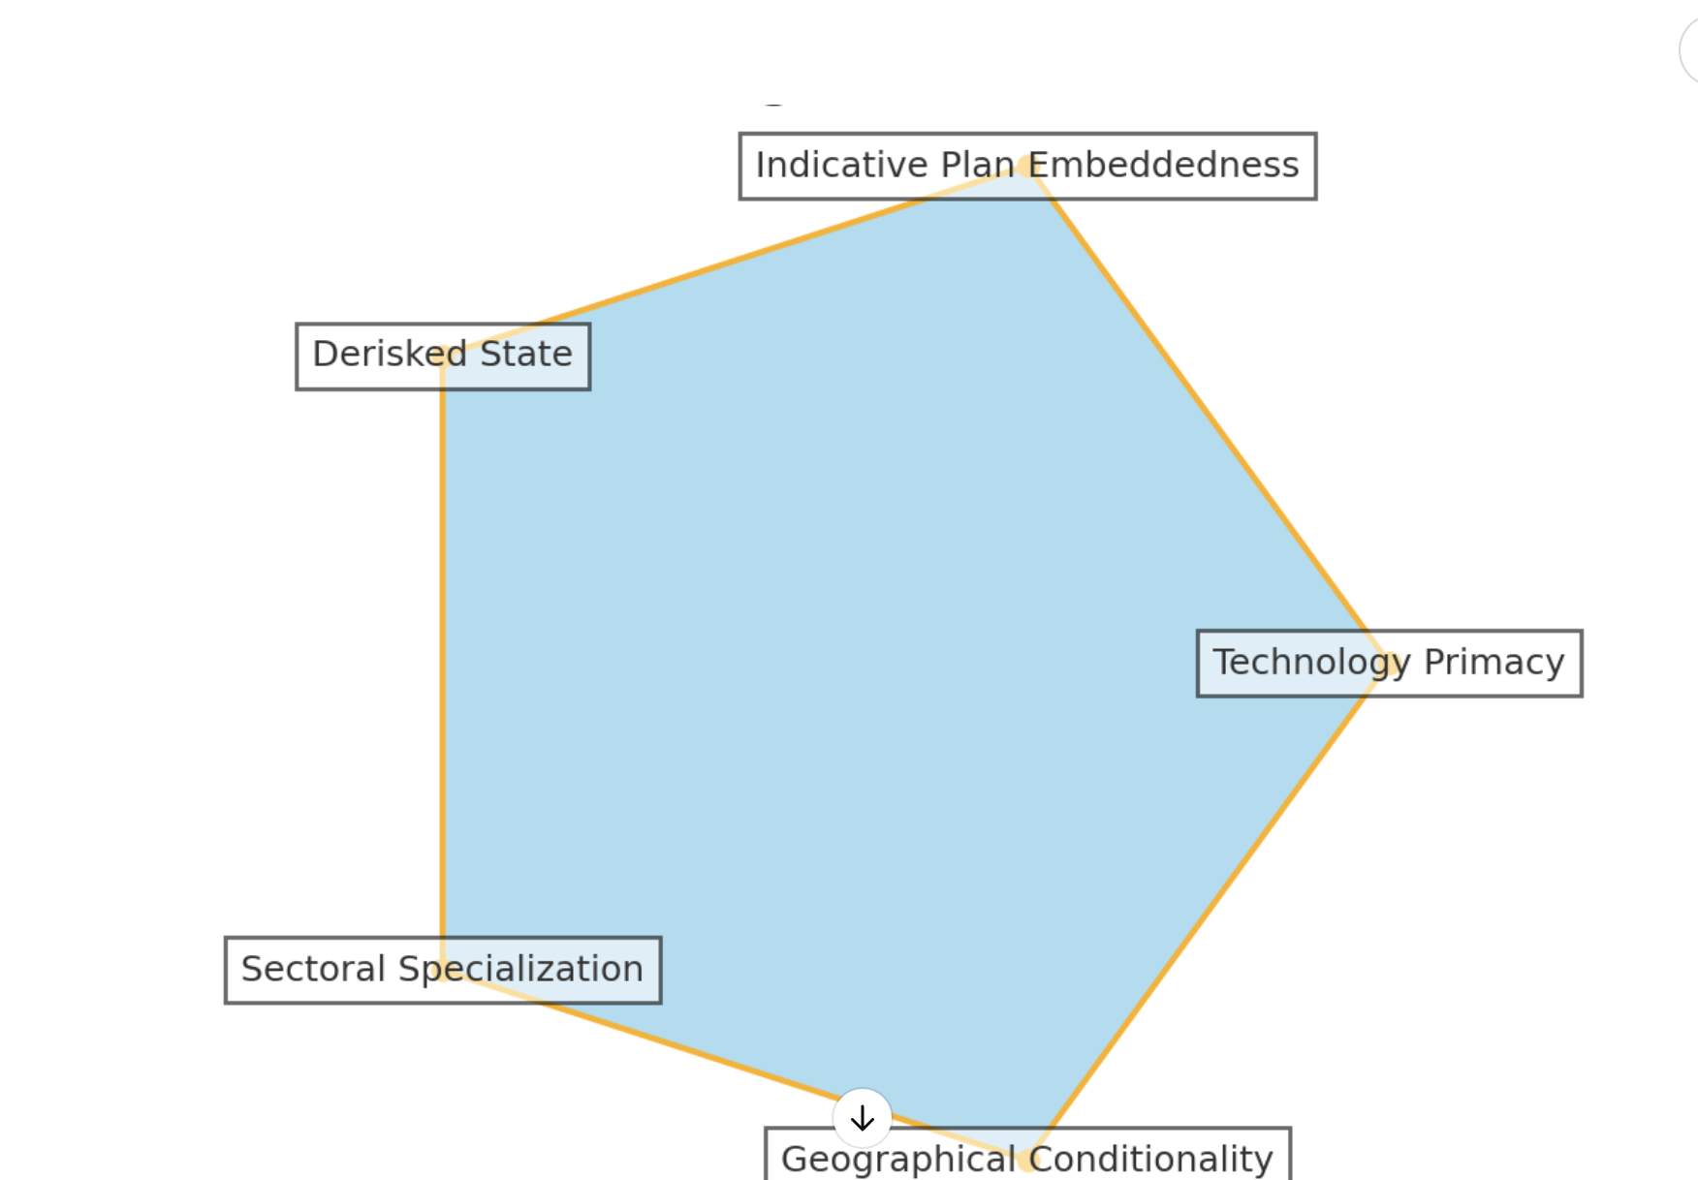
GGFs: The Other Pentagon

Slide 21
1. Profits or technology?
Derisking-based financial statecraft
Developmentalist financial statecraft
Profits are first order in financial statecraft regimes
Profit permanence: EIF always wants its money back with interest
Shareholder value shapes management pay
Policy success is first order in financial statecraft regimes
1. “The government does not really care about return, because it is not their KPI. Their KPI first and foremost is compliance with rules, which ensures that no one will get into trouble. Then it is how many VC funds are created, how many new fields of private investment are created, how many portfolio companies are supported, whether there are star companies in the portfolio. Making profit is the last consideration.”
2. Profit forbearance: When the state wishes to push a certain technology through its mother funds, it can forgo its own profits earned from investing in its sub-fund in favor of the asset managers of the sub-fund and the rest of investors.
3. Technology plan targets not shareholder value shapes management pay: The higher are the subfunds’ risks in supporting emerging local tech development, the higher are the profit transfers to the asset manager

Slide 22
2. Loose or tight coordination?
Derisking-based financial statecraft
Developmentalist financial statecraft
Coordinate primarily private actors, without an indicatively planned effort, to make equity injections into high-risk but high-innovation businesses in sectors defined as critical by the principals
Coordinate primarily state actors (state-owned banks, other state-owned non-banking financial institutions and state-owned enterprises) across different administrative levels in indicatively planned effort to make equity injections into high-risk but high-innovation businesses in sectors defined as critical by planners

Slide 23
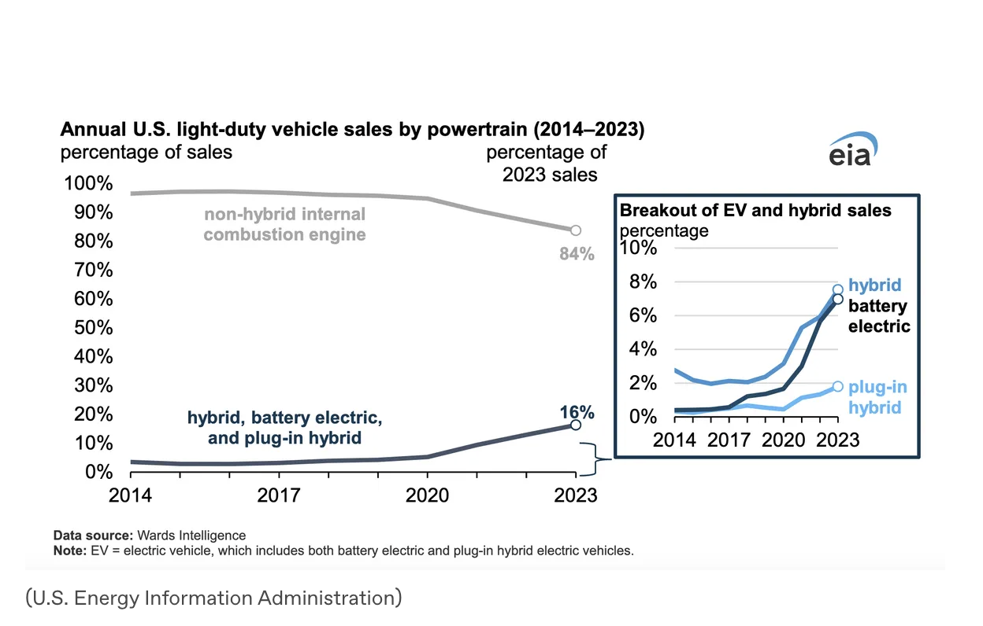
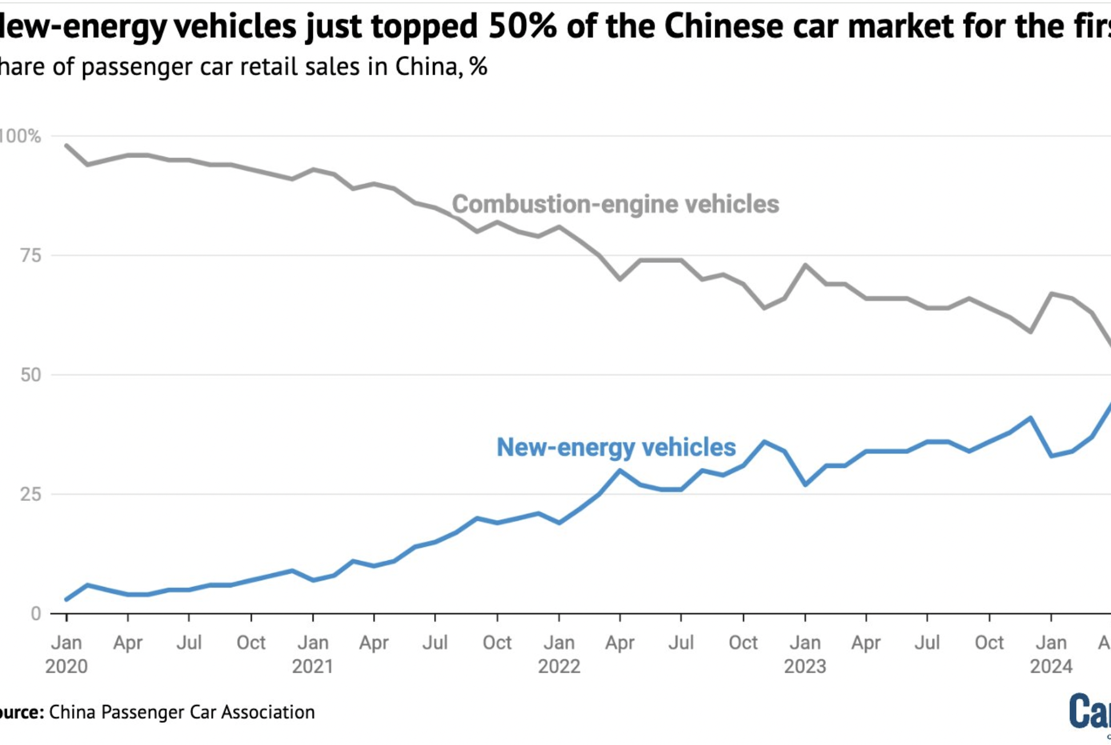
Planning demand matters

Slide 24
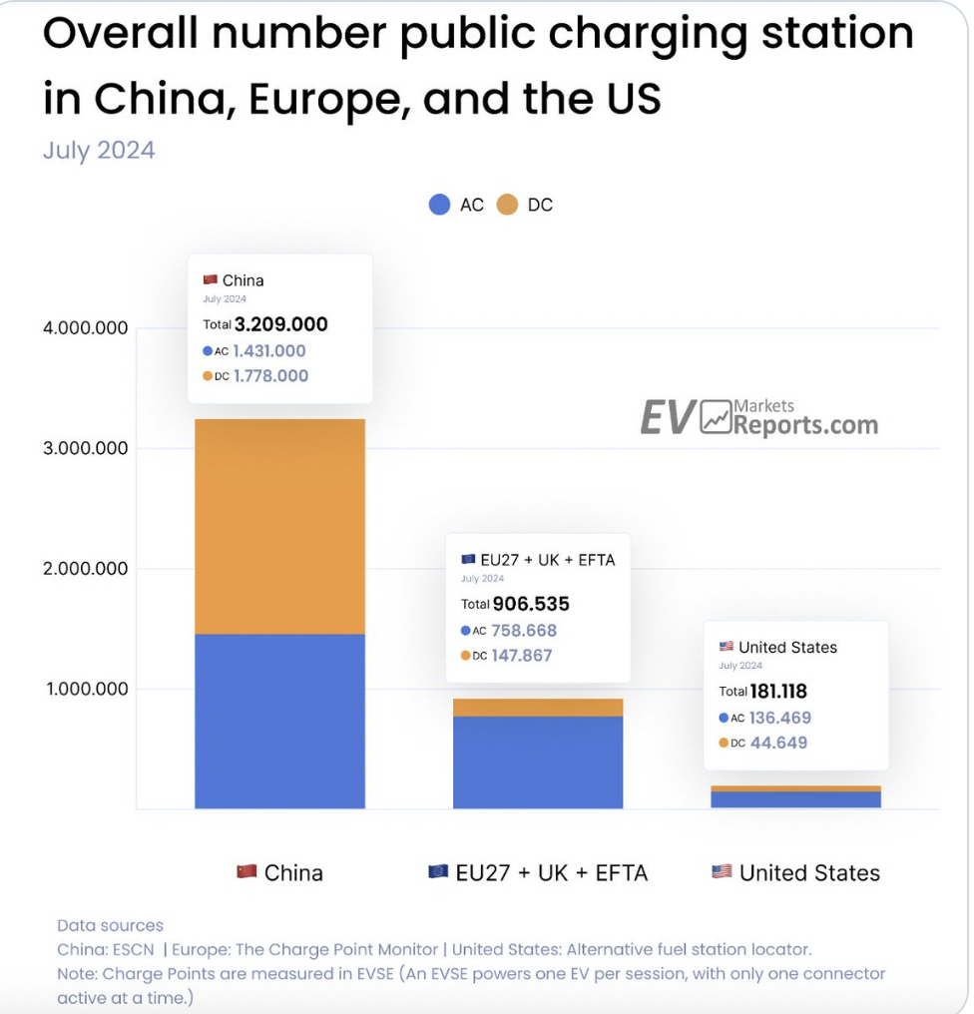
Managing demand
The problem of the European EV industry is not technology (they will surely grow out of their birth pangs),
But the poor management of demand for EVs by the Commission and member states. For demand=EV chargers and on this Chinese central planning works.

Slide 25
3. Who gets most derisked and constrained?
Derisking-based financial statecraft
Developmentalist financial statecraft
No strong bans on activities
Private investors are always derisked
bans on activities not essential to the technological innovation process.
The list of prohibitions is extensive and very constraining (1) Engage in guarantees, mortgages, entrusted loans, and other financing guarantees; 2) Invest in secondary market stocks, futures, real estate, securities investment funds, corporate bonds rated below AAA, trust products, etc
It is state and not private investors who are derisked in case of failure; when a sub-fund undergoes liquidation, after paying off the creditors, the remaining assets repay the mother fund first

Slide 26
4. Generalist financing or specialist sectoral financing?
Derisking-based financial statecraft
Developmentalist financial statecraft
Funds established at government or EU level only acting as direct investors
Weak coordination between EIF and domestic funds
All funds are generalist in terms of technology
Weaker risk appetite
GGF mother funds are established and managed by any level of governments including provincial, city, and county levels and doing indirect equity investments are the main form of GGF
They pool resources from government budgets, state-owned enterprises, and sometimes private sector contributions, with management done by asset managers from policy banks; they can withdraw equity if subfunds fail to meet mother fund investment targets
Indirect investors: They act as limited partners taking equity stakes from sub-funds organized at these sub-national levels and with high sectoral specialization aligned with provincial plans
Subfunds are required by law to invest locally in tech ventures between 100 to 200 percent of the mother fund’s equity investment in the subfund, even though the returns of investment in other securities would be superior (reverse investment ratio)
Reverse investment ratio: if the asset manager achieves the reverse investment target at 150% in local investment, up to 40% of the extra profits will go to the asset manager, which means more than 60% will go to the rest of the shareholders in the sub fund. However, if the asset manager achieves the target of 200% local investment, up to 50% of the profits can go to the asset managers, which means a smaller percentage of the profits will be shared among the rest of the shareholders of the sub fund
High risk appetite

Slide 27
5. Geographical conditionality and risk sharing
Derisking-based financial statecraft
Developmentalist financial statecraft
No geographical conditionality. Purely demand based investments.
GGFs must invest 20% -30% of the target capital size of the sub funds where the sub-funds are incorporated. This:
1.obligates regional (sub-level) public and private shareholders invested in the sub-funds to go local have skin in the local game by increasing their local investments in technological frontier sectors.
2. protects central state assets from potentially failed investments by delegating the power to search winners to local authorities, professionals and (most often state-owned) asset management firms running the sub-funds, enabling risk sharing between the central authorities and the local ones in technologies that are high priority for industrial policy but high risk for conventional finance.
3. cultivates the ‘localism’, spatial experimentalism and decentralization of China’s planned economy, which in turns creates a race for new firms in emerging technologies backed by the plan

Slide 28
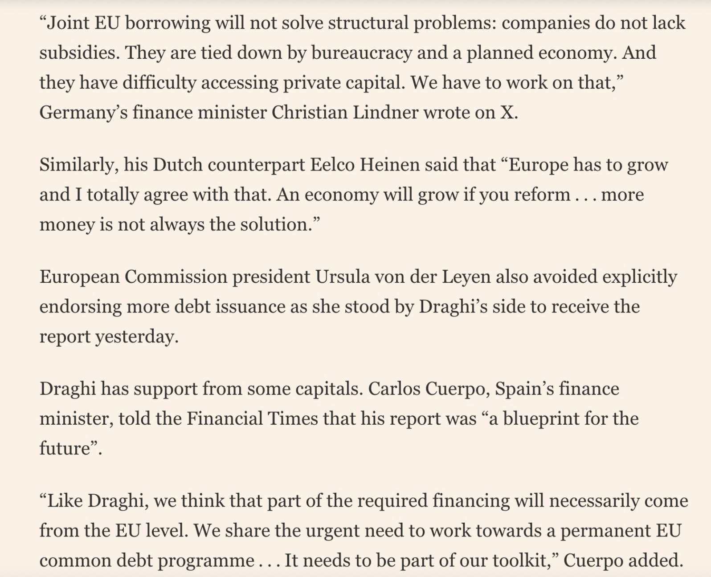
Forget trade war: EU too macro-financially weak for the job
Chances are the Europe will lose this technoeconomic race for non-lithium batteries because its high capital intensity will not be aided by a large EU fund thanks to the usual self-harming objections of the usual suspects who can't even do enough for their own firms

Slide 29
Going forward
In geoeconomic decarbonization, Europe is too weak for a trade war with China even when it's about cars, a key export niche.
Commission will get the tariffs on Chinese EVs through without the support of large members like Spain and Germany
Key European countries cannot live without the Chinese market. The fact that German investments in China grow and regionalise there suggests that a stronger European investment state is better than the "derisking" pushed by politics. Draghi may be right about the 800bn fund!

